Slide 1
WEB GIS Based
Typhoon Disaster Information System
2010. 9
Tae Sung Cheong (bangjaeman@korea.kr)
National Institute for Disaster Prevention
Notes:
1

Slide 2
Contents
1
Introduction
2
Activities of TC and WGDRR
3
WEB GIS Based TCDIS
4
Conclusions

Slide 3
Introduction
TC & WGDRR
Introduce of TC Activities
WGDRR Annual Workshop on Seoul, Korea
Expert Mission for TC Members
TC Integrated Workshop
TC Session
Report on Members DMS & EWS
Collect 12 TC Members Report
Summary and Analysis to Suggest NEW Guideline
WEB GIS Based TCDIS
Collect TC Members Disaster Information Data
Develop A New Analytical Method for WGTCDIS

Slide 4
WGTCDIS
Introduction
Promote the TCDIS to the WGTCDIS
  Develop new interface and statistical method
  Find typhoon trajectory and estimation of typhoon related damages
Research for risk management system
  Survey of risk management institute
  Analysis disaster related site to make distinction
Application of Web GIS based TCDIS
  Establishment of WGTCDIS for Members
  Tool for Early warning system

Slide 5
WGTCDIS
Background and Purpose
To combine domestic DIS and TCDIS into one WEB GIS based system
To try standardizing climate and disaster information for WGTCDIS
To build EWS and DMS to reduce the damages from extreme events by sharing information and results of research
Implementation of WGTCDIS
Data Base
Standardization
System Interface
Enhancement
Expand TCDIS
To other counties
For better contents and enterface
Coping on
Climate Changes
Implementation of
DIS Prototype
Sharing on
DI & Damage Information

Slide 6
WGTCDIS
Work Scopes
Maintenance of TCDIS
For TC members
Problem shooter
Error checking
Hardware maintenance
Database acquisition
Standardization
Data conversion
Function enhancement
DISASTER Management
Statistics and Modeling
Successful
TCDIS
Interface improvement
Analytical methods
Event & regional search
Historical modeling
Reviews & comparison
Future plans
Early Warning Systems
Disaster assessment
Site for Disaster
Enhancement of function
Collect more information
Extend to more Members

Slide 7
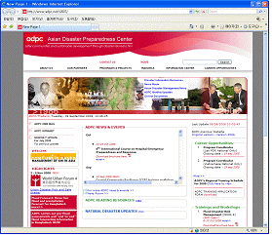
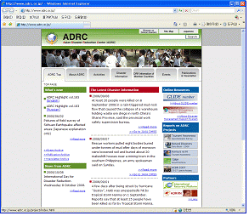
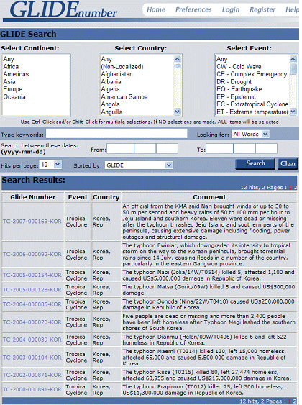
WGTCDIS
Search for Similar Sites
To make a effective WEB GIS based TCDIS
ADPC
(Asian Disaster
Preparedness Center)
ADRC
(Asian Disaster
Reduction Center)
GLIDE Number
(Global IDEntifier Number)
Nonprofit
Regional Response to DPP
Manage training of DPP
Weak of DPP information
27member countries DI
Public inform. for DPP
Annual disaster reports
Weak of statistical inform.
Report on outline of disaster
Define nationally/yearly
Weak of statistical inform
Weak of specific dis. Inform.

Slide 8


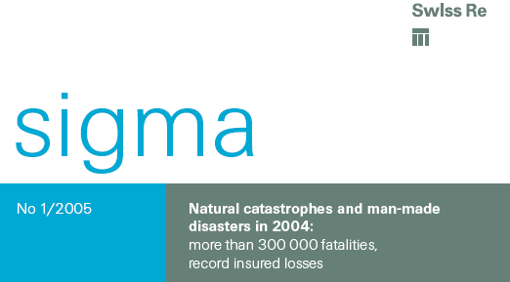
WGTCDIS
Search for Risk Management Institutes
To promote WEB GIS based TCDIS and suggest new system
ArcGIS based natural
dis. risk manage. S/W
Physical Hazard modeling
Detailed disaster information DB
Risk analysis modeling
No consider historical damages
Need lots of information
General typhoon
damage analysis
Based on local disaster damages
Local based DB
Use meteorological information
Historical data based risk manage.
Need met.-damages information
Historical based risk
management
Based on national disaster
Risk modeling for insurance
Difficult to apply in developing
countries have low insurance
subscriber

Slide 9
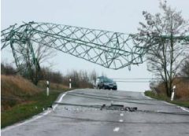
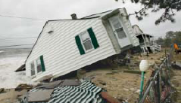
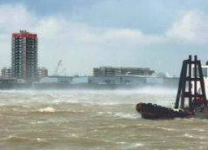
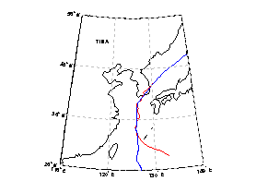
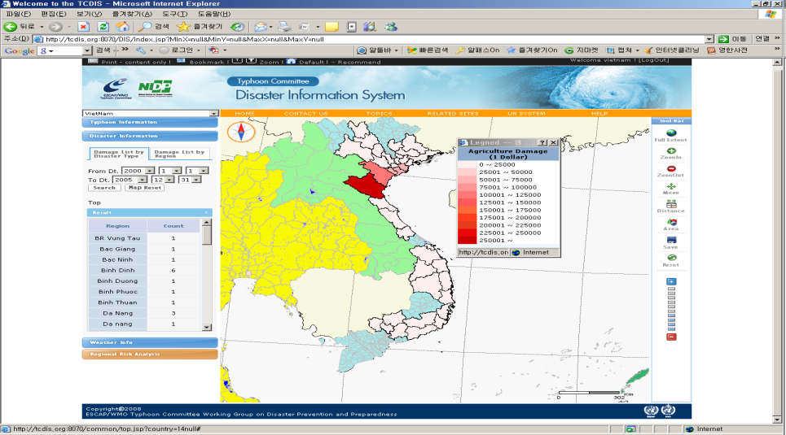
WGTCDIS
Risk Assessment & Management
Detailed Damage Info in Member
Modification & Mitigation Strategy
Similar Typhoon
Estimated Rain & Wind
Comparative Study
제안의 목적
Disaster Type
Damage
Damage Region

Slide 10
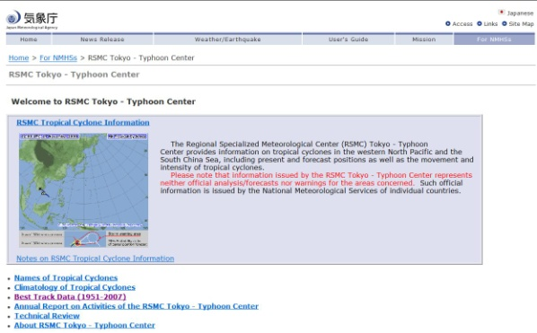
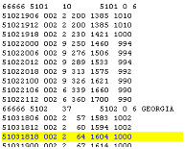
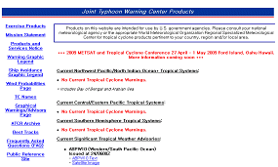
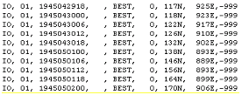
WGTCDIS
Establishment of Typhoon Database
1951~
Total 1515
RSMC(Japan)
RSMC Data Format
1945~
Total 5018
JTWC Data Format
JTWC(USA)

Slide 11
WGTCDIS
Establishment of Typhoon Related Damages DB
 | Disaster Information | Weather Information | Geological Information
Viet Nam | National Unit Local Unit | NCDC Data - Daily Rainfall - Daily Average Wind Data - Daily Maximum Wind Data - Weather Circumstance | Global Mapping Data - National Boundary - District Boundary - Rivers - Main Roads
Laos PDR | National Unit
Philippines | National Unit
Thailand | National Unit
Hong Kong | Local Unit
Korea | Local Unit | Metrological Agency | Detailed GIS MAP
Disaster Information for National Unit : EM-DAT,(1990-2008), http://www.emdat.be
Disaster Information for Local Unit : Viet Nam (1990-2008)
Disaster Information for Local Unit : 홍콩(1968-2007)
Weather Information : 1143 Points, http://www.ncdc.noaa.gov
Geological Information : http://www.iscgm.org
Republic of Korea : 1991–2007

Slide 12
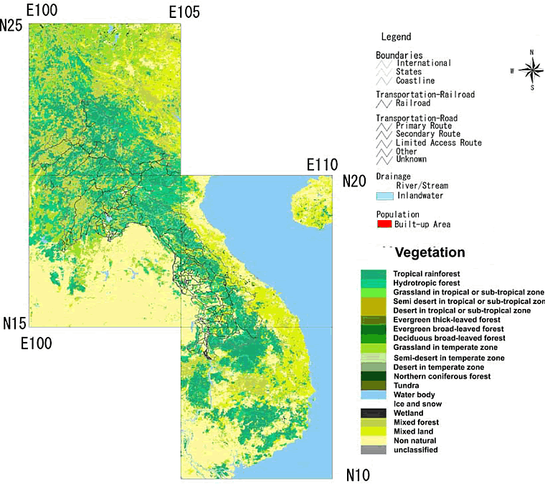
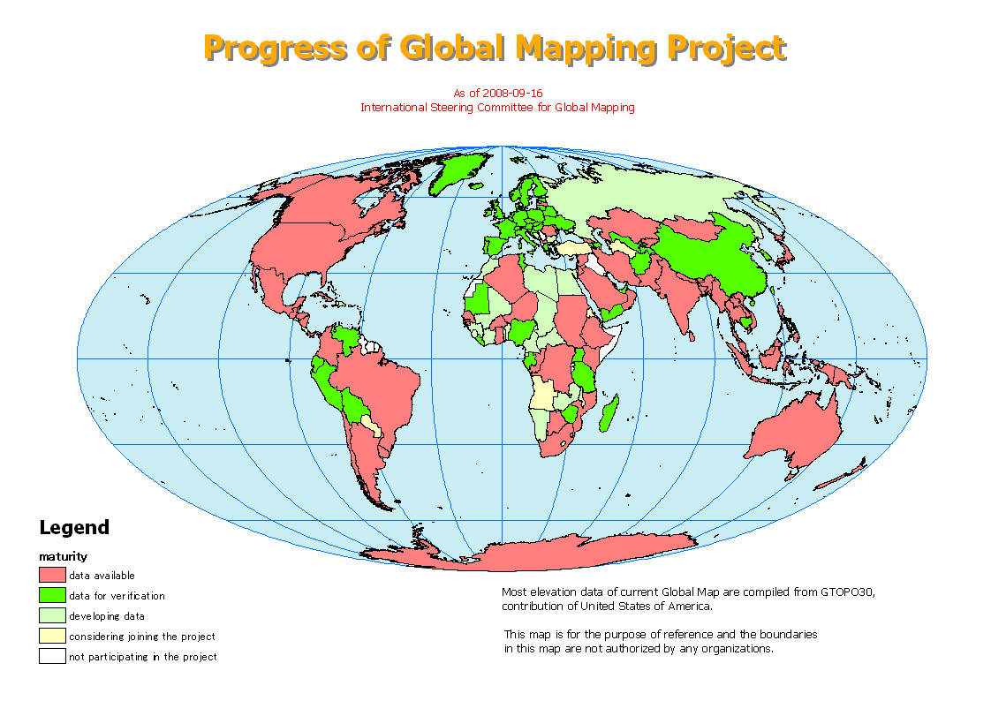
WGTCDIS
Establishment of GIS DB
Transform of Global Map from UN Geographic Information Working Group (UNGIWG)
Vector Map Scale: 1:1,000,000

Slide 13

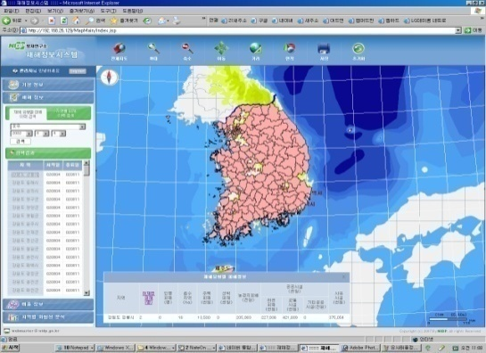
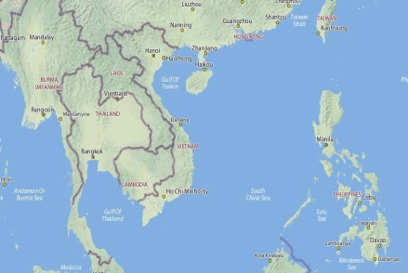
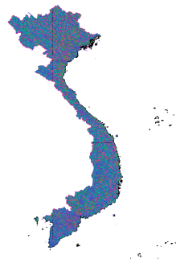
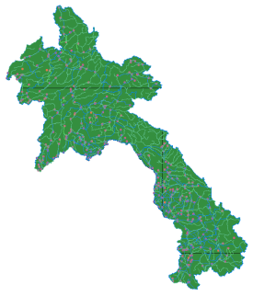
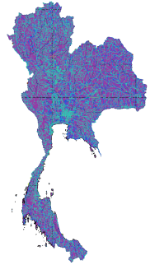
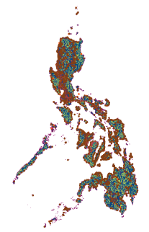
WGTCDIS
Establishment of GIS DB
Integrated Typhoon Information System
Example (Global Map)
Vietnam, Lao, Thailand, Philippine
Questionnaire Example for Philippine
< Questionnaire of digital map in Philippine>
(1) 1: 50000 topographic map----(yes, no)---
digital format (shp, tiff or Jpg else) published map (Hilton will)
(2) 1: 25000 topogrpahic map----(yes, no)---
digital format (shp, tiff or else)
(3) 1: 5000 topographic map for urban areas and 1: 25000
for rural areas--------------(yes, no)
(4) digital elevation data----(yes, no)---
resolution in meters: 30 meter
(5) land use map--- (yes, no)------ MMDA
how many classes are divided into?
(6) national boundary, administration boundary? (yes, no)
(7) main highway and street map? (yes, no)
보 안
Information
Meteorology
Damage
GIS
▪ Rainfall Rate
▪ Max Wind
▪ Mean Wind
▪ Weather Station
▪ Typhoon
▪ Loss of Money
▪ Photo
▪ Map
▪ Weather Station
▪ Damaged Location

Slide 14
WGTCDIS
Establishment of Typhoon Related Damages DB
 | 2008 | 2007 | 2006 | 2005 | 2004 | 2003~ 2000 | Before 1999 | Total
Vietnam | 94 | 55 | 109 | 58 | 5 | 8 | 8 | 337
Philippines | 66 | 21 | 155 | 1 | 44 | 40 | 32 | 359
Thailand | 0 | 0 | 14 | 2 | 0 | 3 | 5 | 24
Laos | 6 | 1 | 4 | 0 | 0 | 2 | 0 | 13
Hongkong | 28 | 2 | 14 | 0 | 0 | 5 | 33 | 82
Guam | 0 | 1 | 0 | 0 | 0 | 21 | 10 | 32
Total | 194 | 80 | 296 | 61 | 49 | 79 | 88 | 847
.
Total Observed Data
.

Slide 15
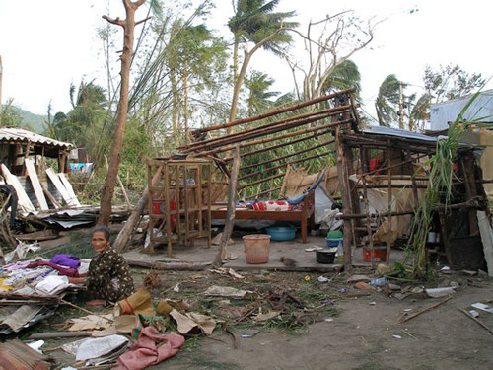
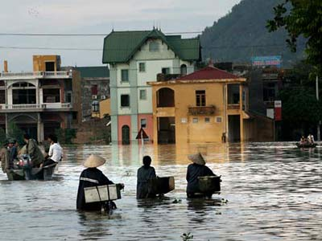
WGTCDIS
Collecting Disaster Information
National | Local | Typhoon | Date | Site | Contents
Viet Nam | Thua Thien Hue | Xangsane | 2006.10.2 | http://www.dwf.org/blog/project... | ECHO Xangsane Reconstruction
Viet Nam | Quang Binh | Lekima | 2007.10.4 | http://www.cbc.ca/world/story/2007/10/03/typhoon... | Typhoon batters one of Vietnam's poorest regions
Viet Nam | SON LA | Hagupit | 2008.9.29 | http://english.vietnamnet.vn... | Floods claim 41 deaths in northern region
Obtained 730 Disasters Information from 14 TC Members

Slide 16
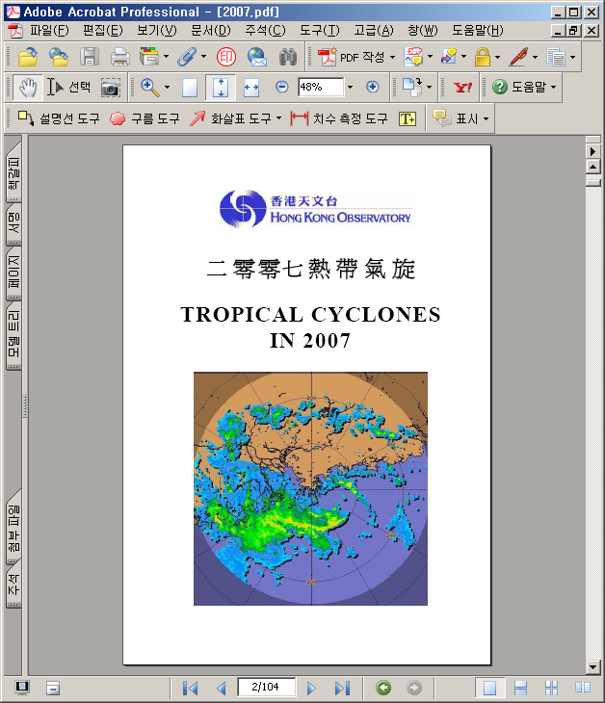
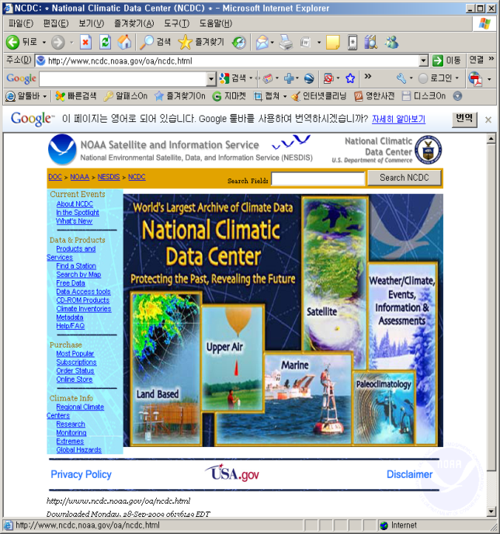
WGTCDIS
Collecting Disaster Information
Disaster Information
Hong Kong Observatory
(www.weather.gov.hk)
Weather Information
NOAA
(ftp.nce.noaa.gov)
1968~Now, PDF
1973~Now, TXT

Slide 17
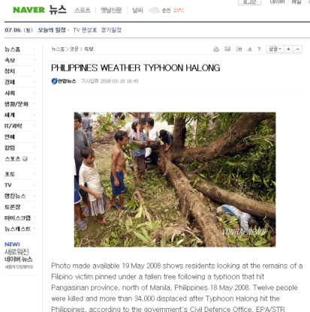
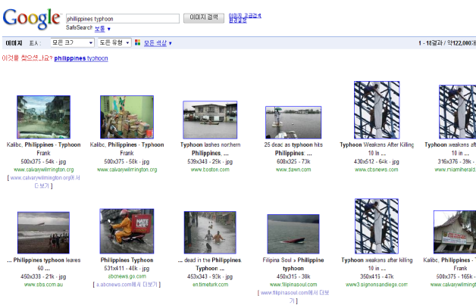
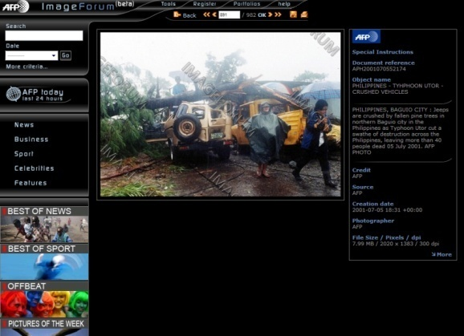
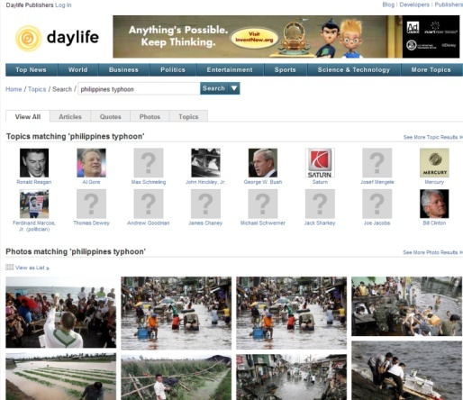
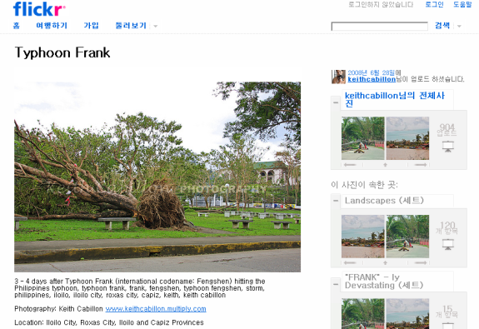
WGTCDIS
Collecting Disaster Information
news.naver.com
images.google.co.kr
www.imageforum-diffusion.afp.com
www.daylife.com
www.flickr.com

Slide 18
WGTCDIS
Standard Format for WGTCDIS
disaster code | 19910101 (the date for a specific meteorological phenomena, the same to the weather information)
province | area surrounded by the first level of administration boundaries
county | area surrounded by the second level of administration boundaries
amount of damage | dollar in 2005 trans-calculated from domestic money rate
victim | the number of the dead and missing
human | the number of the wounded
flooded area | areas of flooded, m2 or the names of areas affected
house | the number of demolished (partly or wholly)
ship | the number of broken ship
farmland | the damage of agricultural lands
river | names of inundated river
transportation | missing or broken lines, meter
other public | building or other social damage
private damage | estimated

Slide 19

WGTCDIS
DB Structures
Appropriate Scope
Of DB
Standardization of DB
Optimized DB Structure
Selection, Abstraction and Transformation
Preparation
Country-wise Data
Integrated DB
Selection
Abstraction
Data Acquisition
Meteorological
Data
Meteorological
Data
Selection
Abstraction
Damage
Data
Transformation
Damage
Data
Data Analysis
Selection
Abstraction
DB Standardization
GIS
GIS
Transformation
Using Common Formation

Slide 20
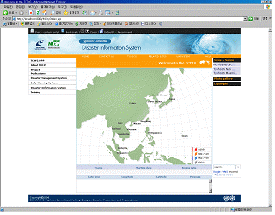
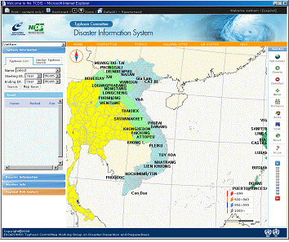

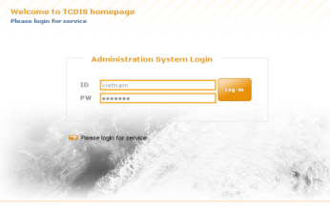
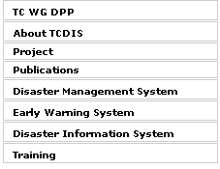
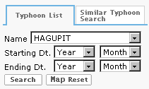
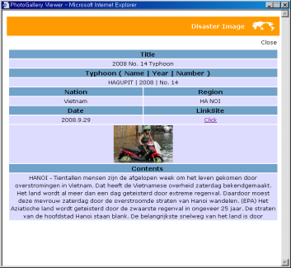
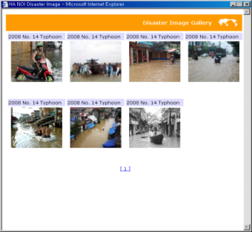

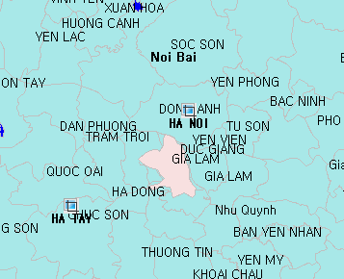
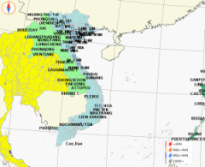
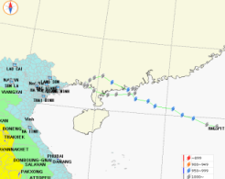
WGTCDIS
Process for Presentation of Disaster Information

Slide 21
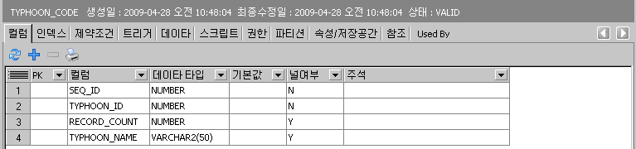
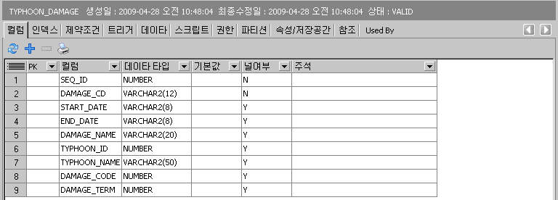
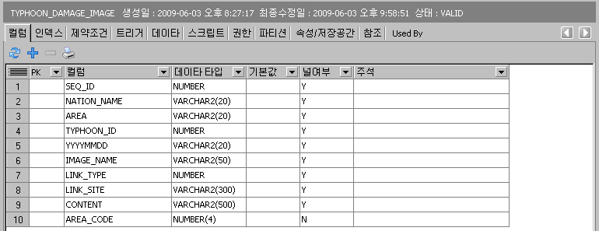
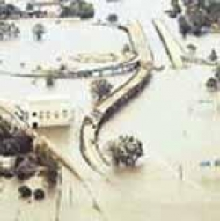


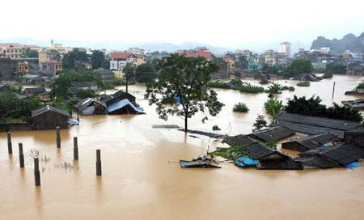
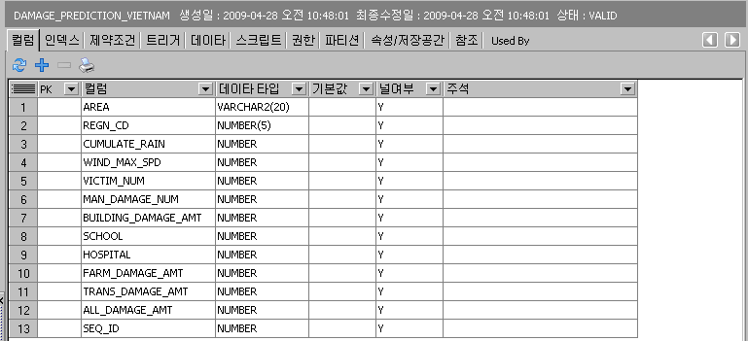
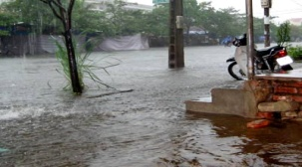
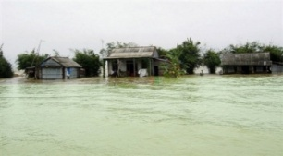
WGTCDIS
DB Structures for Presentation of Information
Damage Information

Slide 22
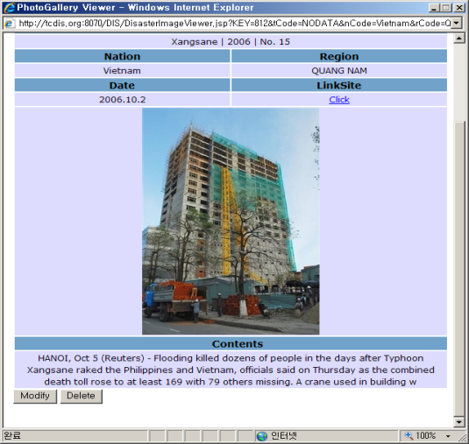
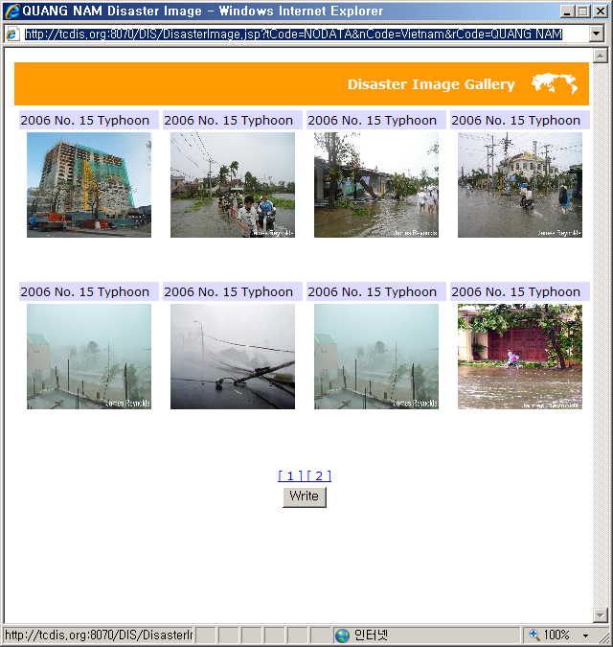


WGTCDIS
Upload Damage Photos
Modify or Delete
Upload

Slide 23





WGTCDIS
GEO-Linking Presentation for Damage Photos
Click

Slide 24


WGTCDIS
Analysis of Typhoon Characteristics
Viet Nam Typhoon Disasters
Duration
Damage Area
Average number of typhoon is 5
Maximum number of typhoon is 18
May ~ June: North Area
December: South Area (Weak)

Slide 25


WGTCDIS
Analysis of Typhoon Characteristics
Viet Nam Typhoon Disasters
Monthly Typhoon Disasters
Typhoon Trajectories
Concentrated on 9~10
Move from South China Sea to West

Slide 26


WGTCDIS
Analysis of Typhoon Characteristics
Viet Nam Typhoon Disasters
Hanoi
Central Pressure
Sarah (1977)
Hanoi
Maximum Wind Velocity
Damrey (2005)

Slide 27





WGTCDIS
Governing Equation
Variables to estimate similar typhoon trajectory
Pressure Distribution
Atmospheric
Pressure
Central
Pressure
Length from
Center
Constant
A=B=1 (Maemi & Rusa)
Wind Speed Distribution
Length from Center
Corioles Constant
Atmospheric Density
Wind Speed Distribution of Nari

Slide 28




WGTCDIS
Develop A NEW Method
Extend Boundary Condition
Latitude 0~60º
Longitude 90~160º
Add Pressure Distribution Parameters
Extend Application Area
Add Wind Speed Distribution Parameters

Slide 29









WGTCDIS
Calibration of NEW Method
Trajectory of Typhoon (Korea)
Typhoon NARI
1st: GILDA(1974), old: 4th
2nd : THELMA(1987), old: 3rd
3rd : TINA(1997), old: 1st
4th : CAITLIN(1991)

Slide 30








WGTCDIS
Calibration of NEW Method
Trajectory of Typhoon (Viet Nam)
HAGUPI (2008)
1st : HAGUPIT & SALLY(1996)
2nd : HAGUPIT & YUTU(2001)
3rd : HAGUPIT & KENT(1995)

Slide 31




WGTCDIS
Validation of New Typhoon Trajectory Estimation Method
Comparisons with KUJIRA(2009)
1st level : KETSANA(2003)
Mismatch on Trajectory
5th level : POLLY(1995)
Mismatch on Pressure

Slide 32


WGTCDIS
Validation of New Typhoon Trajectory Estimation Method
Comparisons Between POLLY and KUJIRA
Pressure : POLLY > KUJIRA
SST : POLLY > KUJIRA
POLLY (1995) : EM-DAT
Death : 430, Surfers : 44,000
Damages : 700 M USD
KUJIRA (2009) : News
Death : 20
POLLY
KUJIRA

Slide 33




WGTCDIS
Validation of New Typhoon Trajectory Estimation Method
1999 BART
Rainfall : 271mm
Pre-Rainfall : 32.5mm
Max. Wind : 16.7m/s
Damages : 102M USD
2003 MAEMI
Rainfall : 197mm
Pre-Rainfall : 49mm
Max. Wind : 39.5m/s
Damages : 450B USD
2000 SAOMAI
Rainfall : 285mm
Pre-Rainfall : 97mm
Max. Wind : 18.7m/s
Damages : 15.6M USD

Slide 34
WGTCDIS
Type of Typhoon Trajectories
Typhoons during 1991-2005 (25)
West Sea (9)
South Sea (9)
South-East Sea (7)
TED (9219)
BRENDAN (9411)
DOUG (9413)
ELLIE(9414)
KAITAK(0004)
RAMMASUN (0205)
MINDULLE (0407)
GLADYS (9112)
SETH (9429)
FAYE (9503)
TINA (9711)
YANNI (9809)
SAOMAI (0014)
RUSA (0215)
MAEMI (0314)
MEGI (0415)
CAITLIN (9109)
MIREILLE (9119)
PERCY (9306)
ROBYN (9307)
OLIWA (9719)
BART (9918)
SOUDELOR (0306)
SONGDA (0418)
NABI (0514)

Slide 35





WGTCDIS
Type of Typhoon Trajectories (West Sea)
Rainfall : 47~151 1000M ton
BRENDAN (9411)
DOUG (9413)
ELLIE(9414)
KAITAK(0004)
MINDULLE (0407)
TED (9219)
BRENDAN (9411)
DOUG (9413)
ELLIE(9414)
KAITAK(0004)
RAMMASUN (0205)
MINDULLE (0407)

Slide 36
WGTCDIS
Type of Typhoon Trajectories (West Sea)

Slide 37









WGTCDIS
Type of Typhoon Trajectories (South Sea)
Rainfall : 100-300 1000M ton
GLADYS (9112)
SETH (9429)
FAYE (9503)
TINA (9711)
YANNI (9809)
SAOMAI (0014)
RUSA (0215)
MAEMI (0314)
MEGI (0415)
GLADYS (9112)
SETH (9429)
FAYE (9503)
TINA (9711)
YANNI (9809)
SAOMAI (0014)
RUSA (0215)
MAEMI (0314)
MEGI (0415)

Slide 38
WGTCDIS
Type of Typhoon Trajectories (South Sea)
Max Wind (m/s)
Damages (M USD)
Central Pressure (mb)
Max Wind (m/s)

Slide 39







WGTCDIS
Type of Typhoon Trajectories (South-East Sea)
누적 강수량 분포 : 30-270 1000Mton
CAITLIN (9109)
MIREILLE (9119)
PERCY (9306)
ROBYN (9307)
BART (9918)
SOUDELOR (0306)
NABI (0514)
CAITLIN (9109)
MIREILLE (9119)
PERCY (9306)
ROBYN (9307)
OLIWA (9719)
BART (9918)
SOUDELOR (0306)
SONGDA (0418)
NABI (0514)

Slide 40
WGTCDIS
Type of Typhoon Trajectories (South-East Sea)

Slide 41
WGTCDIS
Redevelop the WGTCDIS
OLD Version
NEW Version
NNM (Nearest Neighbor Method)
Compare with trajectory and
central pressure
Select similar typhoon by
minimize error function, f = (t,c)
- Problems
- Depend on only trajectory and
central pressure (wind, SST, etc)
- Week on considering on typhoon
affecting boundary
NNM (Nearest Neighbor Method)
EMF (Ensemble Mean Forecast)
Compare with trajectory, central pressure
and typhoon affecting boundary
Select similar typhoon by comparing with
special correlation
- Better Points
- Set the correlation considering both
trajectory, central pressure
- Use Ensemble Mean Forecast method

Slide 42
WGTCDIS
Redevelop the WGTCDIS
Relationship between Central Pressure
and Max. Wind Speed
(1951-2008, RSMC, 1547 Typhoons)
Relationship between Central Pressure
and 30kts Wind Speed Boundary
(1951-2008, RSMC, 1547 Typhoons)

Slide 43
WGTCDIS
Estimation of Typhoon Trajectory
Initial Time x(t0)
Forecast of Each Member
Forecast P(t=t₂)
Ensemble Mean
Forecast x(t₁)
Analysis Field
Deterministic Forecast
Initial PDF is represented by multiple initial conditions which are slightly different from analysis field.
Future PDF (range of forecast error) is estimated from multiple forecast
Forecast by same model
The ensemble prediction is a set of forecasts generated by NWP started from only slightly different initial conditions (added the perturbation into the analysis field).

Slide 44
WGTCDIS
Estimation of Typhoon Trajectory
“Ensemble mean forecast” is average of all ensemble forecasts. It is approximately equal to the central value of forecast PDF.
Statistically, ensemble mean error, which is defined as the mean square distance between ensemble mean forecast and analysis, is almost half of deterministic forecast’s error.
Ensemble Mean Forecast
Analysis Field
Deterministic Forecast

Slide 45
WGTCDIS
Validation Results
Normalized Spatial Correlation of Affected Region
Corr. Coeff = 89.1%
2003 MAEMI
1959 SARAH

Slide 46
WGTCDIS
Validation Results
Normalized Spatial Correlation of Affected Region
Corr. Coeff = 81.1%
2003 MAEMI
1974 GILDA

Slide 47



WGTCDIS
Validation Results
2009 14th Typhoon, CHOI-WAN
- 2009.9.16 07:00 (KMA)
Similar Typhoon Results
°
CHOI-WAN - dir= -63.520 -36.560
45
N
1 :DORIS : DPrms=0.835 dir= -55.050 -43.600
1958 DORIS
Year : 1958 Order : 13
°
30
N
2009 CHOI-WAN
°
15
N
°
90
°
E
°
150
E
105
E
°
- 2009.9.16 07:00 (JTWC)
°
135
E
120
E
Final Trajectory

Slide 48
WGTCDIS
Validation Results
2009 SOUDELOR
No big damages
1967 CARLA
2001 FITOW
EM-DAT : No damages

Slide 49






WGTCDIS
Estimation of Typhoon Trajectory
Typhoon
DB
Sea Surface
Temperature DB
KDF Analysis for SST
NNM Analysis of Path & Central Pressure
SST Distribution around Typhoon Path
Path
= f(Pressure, Radius, SST)
Effects of SST
Past Typhoon
Current Typhoon
Characteristics of Typhoon
Correlation with wind & rain
KDF Of
Typhoon
Similar Past Typhoon

Slide 50
WGTCDIS
Estimation of Typhoon Trajectory
Disaster Model
Injae-Gun
Damage
Rainfall
Past Damage Info.
Damages (US$)
Inconsistency in rain
& damage
Cumulated Rainfall (mm)
Weather Info.
Flood A Flood B
Cause Analysis
Damage Reduction due to
Post-Mitigation Measures
Modification of Regional Vulnerability
Damage
Max Wind
Rainfall

Slide 51
WGTCDIS
Estimation of Typhoon Related Damages
Multi Variable Interpolation Analysis
Total Damages in Quang nagi
Multi Variable Interpolation

Slide 52
WGTCDIS
Estimation of Typhoon Related Damages
KDF Analysis
Total Damages in Quang nagi
Result from KDF Analysis

Slide 53
WGTCDIS
Estimation of Typhoon Related Damages
Quang nagi
Agricultural Area
Suffers
Rainfall/Wind
School
Death

Slide 54
WGTCDIS
Estimation of Typhoon Related Damages
Binh Dinh
Total Damages
Transportation
Utilities
Rainfall/Wind
Agricultural Area
Death
Rainfall
Wind

Slide 55
WGTCDIS
Estimation of Typhoon Related Damages
Bghe An
Total Damages
House
Rainfall/Wind
Transportation
Utilities
Death
Rainfall

Slide 56
WGTCDIS
Estimation of Typhoon Related Damages
Khanh Hoa
Total Damages
Death
Wind

Slide 57




WGTCDIS
Risk Assessment
Typhoon Disaster
Typhoon Disaster Type
Regional
Damage
Typhoon Info.
Web-GIS based TCDIS
Cause
Damage
Loss
DB
Loss
Period
Type
Disaster
GIS
Typhoon
Path
Pressure
Maps
KMA Information
Damage
Assessment
Risk Assessment

Slide 58


WGTCDIS
Main of WGTCDIS
Main Features of TCDIS was developed following as WMO (World Meteorological Organization) Web Style Guide
TCDIS Main
WMO Main

Slide 59





WGTCDIS
Searching for Similar Typhoon
Click
Typhoon BART
Click
Click

Slide 60


WGTCDIS
Disaster Information
Estimates Similar Typhoon Trajectory
Estimates Typhoon Related Damages

Slide 61


WGTCDIS
Protect Disaster Information
Typhoon NABI Information
Estimates Typhoon Related Damages
Estimates Typhoon Related Damages

Slide 62





WGTCDIS
Present Damage Information

Slide 63



WGTCDIS
Results Comparisons
유사성 표출
Central Pressure

Slide 64


WGTCDIS
Disaster Information
Trajectory of Typhoon (Viet Nam)
Typhoon Related Damages
Typhoon Trajectory

Slide 65


WGTCDIS
GEO Linking Disaster Information
Weather Station
Past Meteorological Data
Country-wise Disaster Info.
Typhoon Info.
Damage Statistics
Damage Phtos.
Standard Code & DB for Management
Integrated DB
Thai.
Phil.
Abstraction

Slide 66








WGTCDIS
GEO Linking Disaster Information
Display
GIS-base Damage Info.
Typhoon Information System
1st, 2nd Phase
Geo-linking
Geo-linking
Geo-linking
Typhoon Weather
Damage (GIS)
Damage
(Graph)

Slide 67

WGTCDIS
WGTCDIS Manual

Slide 68
Conclusion
1
Introduction
2
Activities of TC & WGDPP
3
WEB GIS Based TCDIS
4
Conclusion
Conclusion

Slide 69
Conclusion
Report Annual Activities of TC
Suggest Future Work Plan
Collect DMS and EWS from 12 TC Members
China; Hong Kong, China; Japan; Lao PDR; Malaysia; Philippines;
Republic of Korea; Macao, China; Singapore; Thailand; USA; and Viet Nam
Summary and Report on WEB GIS Based TCDIS
Development of New Estimation Method to
estimate the Typhoon Trajectory and Damage

Slide 70
Thank you…
Tae Sung Cheong Ph.D(bangjaeman@korea.kr)
National Institute for Disaster Prevention

